Slide 1
The Islamic World:
Religion and Culture

Slide 2
Muhammad and Islam
Centuries before the time of Christ. Nomadic Arabs known as Bedouins lived in the desert peninsula of Arabia east of Egypt. Bedouins Arabs were an animistic, tribal people who worshiped some 300 different nature deities. Until the sixth century C.E., the Arabs remained polytheistic and disunited, but the birth of the prophet Muhammad in 570 in Mecca changed these circumstances dramatically.
Orphaned at the age of six, Muhammad received little formal education. He traveled with an uncle on caravan journeys that brought him into contact with communities of Jews, Christians, and pagans. At 24, he married a wealthy widow and became a prosperous merchant.
Long periods of isolation and quiet meditation led Muhammed to receive a message: according to Muslim teachings, after three nights of visions, the Angel Gabriel appeared to Muhammad an commanded him to receive the revelation of the one and only Allah. Now forty-one years old, Muhammad declared himself the final messenger in a history of religious revelation that had begun with Abraham and continues through Moses and Jesus. WHY MIGHT THIS IDEA HAVE BEEN HARD FOR MOST ARABS TO FOLLOW?
While Muhammad produced no new doctrines, he emphasized the bond between Allah and his followers, and the importance of the community of the faithful, whose unswerving love of God would govern every aspect of their lives and conduct. His message reinforced many of the basic precepts of Christianity and Judaism.
Similar aspects between Islam and Christianity are the immortal soul, the anticipation of a final judgment, and the certainty of Heaven and Hell. Other aspects of the Islamic faith, such as uncompromising monotheism, a strict set of ethical and social values, and special dietary laws, were fundamental to the Hebraic faith.

Slide 3
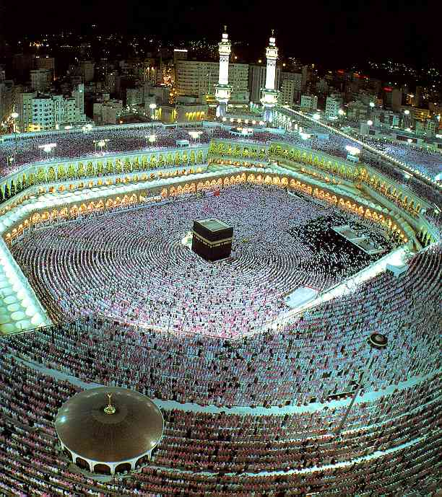
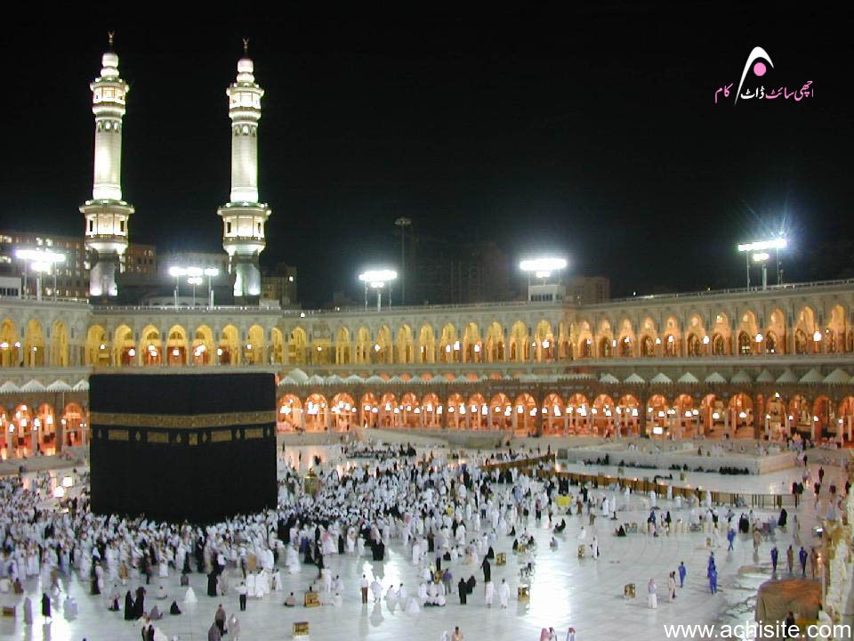
The Kaaba, Mecca,
Saudi Arabia

Slide 4
At the onset, Muhammad’s message attracted few followers, with only his family accepting his call. His attack on idolatry threatened Mecca’s prominence as a prosperous pilgrimage site, and the Meccan elite actively resisted the new faith, (why?) leading to much armed conflict.
Representatives of the Meccan authorities offered Muhammad bribes to quiet him, which he briskly turned down. He simply refused to stop preaching and reciting the Qur’an. Eventually, the Meccan authorities resolved to wipe out his movement. His followers were persecuted and his family broke off ties with him. His uncle and biggest protector died around this time and he was the target of several assassination plots.
Roughly 13 years after Muhammad proclaimed the unity of God in the streets of Mecca, his movement was in shambles. In 622, after twelve years of indecisive warfare with the Meccan opposition, the Prophet abandoned his native city with his new religious ideals at a stand still. Along with some seventy Muslim families, he emigrated to Medina (City of the Prophet). It would be eight years before the population of Medina converted to the Muslim faith.
The year 622 is celebrated by Muslims as the first year of the Muslim era. The year is significant because it marks the point in Muhammad’s mission when he stopped being the leader of a persecuted minority, and started being the leader of a community governed by Islamic law.
When Muhammad returned to Mecca with a following of 10,000 men, the city opened its gates to him. Muhammad conquered Mecca and destroyed all idols, and assumed spiritual and political authority—establishing a theocracy that bound religious and secular realms in a manner not unlike that of the early Hebrew kings.

Slide 5
Muhammad himself wrote nothing, but his disciples memorized his teachings and recorded them some ten years after his death. Written in Arabic, the Qur’an (literally, recitation”) is the holy book of Islam. The Muslim guide to spiritual and secular life, the Qur’an/Koran consists of 114 chapters, ach one opening with the invocation, “In the name of God, the Lord of Mercy, the Giver of Mercy.”
The contents of the Qur'an/Koran were delivered to Muhammed from God through the Angel Gabriel. Then, Muhammed orally transmitted these ideas to his disciples who in turn recorded the information which would become the Qur'an/Koran. The creation of the holy book of the Muslims is considered the central miracle of Islam. Unlike the Bible, the Qur'an/Koran is not compiled thematically or written narratively, but rather exists as Arabic poetry of the highest order.
It condemns drinking wine, eating pork, and all forms of gambling. Islam limits polygamy to no more than four wives, provided that a man can provide and protect all of them. Although the Qur’an/Koran defends the equality of men and woman before God, it describes men as being “a degree higher than woman,” and endorses the pre-Islamic tradition requiring women to veil their bodies from public view.
Muslim scripture reveals the nature of God and the inevitability of judgment and resurrection. It teaches that human beings are born in the purity of God’s design, free from Original Sin. To those who practice submission, humility, and reverence for God, it promises a hereafter resembling a garden of paradise. To the wicked and to the non believers, it promises terrifying punishments of Hell.
Muslims consider the Qur’an the eternal and absolute word of God. Chanted or recited, rather than read silently, it is often committed to memory by the devout. The Qur’an is also the primary text for the study of the Arabic language. It is considered untranslatable, not only because its contents are deemed holy, but because it is impossible to capture in other languages the musical nuances of the original Arabic.

Slide 6
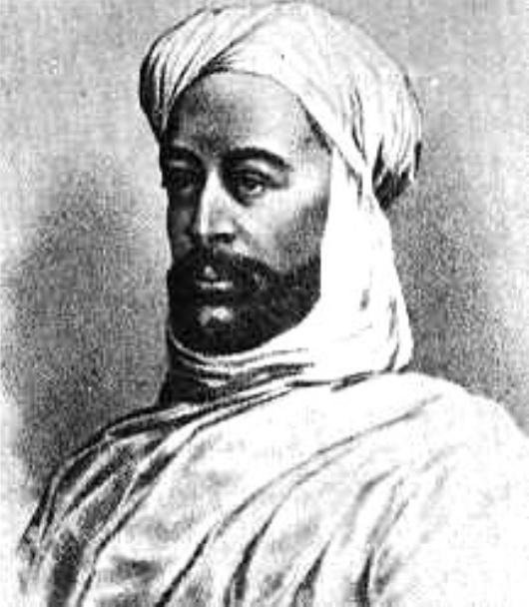
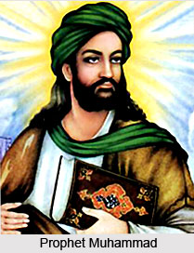
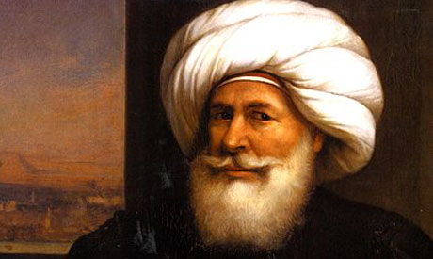
Muhammad’s followers are called Muslims “those who submit to Allah.” They use the word “submit” because they believe that submission is the straight path to God. They honor him as the last of the prophets, human rather than divine in nature. They acknowledge Allah as the one true god, identical with the god of the Jews and the Christians.
Fulfilling the Judeo-Christian tradition of deliverance, Islam, claims to complete God’s revelation to humankind. The declaration of faith in Allah and his Messenger is the first of the so-called Five Pillars of Muslim practice.
In addition to carrying out the commitments outlined in the Five Pillars, Muslims observe a general obligation to commend good and reprimand evil.

Slide 7
The Five Pillars of Muslim Faith:
Confession: Confession of faith: “There is no god but Allah, and Muhammad is his Messenger.”
Recitation: Recitation of prayers five times a day, facing Mecca.
Almsgiving: The practice of making charitable contributions to the Islamic community.
Fasting: Fasting from dawn to sunset during the sacred month of Ramadan (during which Muhammad received his calling).
Pilgrimage (hajj): Pilgrimage to the holy city of Mecca at least once in a Muslim’s lifetime.

Slide 8
Islam Day to Day:
Sunni Muslims pray five prayers, with particular prayer rituals connected to particular times of the day: before dawn, just before noon, midafternoon, just after sunset, and in the evening. Shia Muslims perform five prayer rituals with the same names and same durations as the Sunni, but do so within three daily time slots: before dawn, just after noon, and just after sunset.
Although the are some exceptions made for the sick and for travelers, these prayers must be rendered faithfully and with full attention, regardless of one’s physical location. Those engaging in prayer must be ritually clean, removing their shoes and performing a cleansing ritual on the hands, face, mouth, and feet.
At noon on Friday, the Islamic Sabbath day, the Islamic community gathers in the mosque for a service of prayer lasting 30 minutes to an hour. Shoes are not worn in the mosque and men and women pray separately so as not to distract each other. For males, attendance at the Friday prayers is required, with skipping services regarded as a sin.
Several important life rituals are prominent in the Islamic faith. The welcoming ritual or birth ceremony is known as akikah, and celebrated only by some Muslims as birthdays are not celebrated in the Islamic system. Initiation, or shahada, marks a young Muslim’s formal entry into the faith. Commonly taking place during one’s middle teens, this ceremony must be witnessed by a prescribed number of adult Muslims. An Islamic funeral service is straightforward and includes prayers for the dead and burial within 24 hours. Cremation is not sanctioned in Islamic culture.
The holy festival of Ramadan occupies the whole of the ninth month of the Islamic calendar. Ramadan is a time of daily repentance and fasting, where adults embark on a rigidly observed period of abstention, reflection, and purification. Muslims are expected to forego all indulgences, to reflect on their past misdeeds, to reinforce personal discipline, and to express gratitude to Allah for his continued direction and daily presence in the life of the believer. Between sunrise and sunset during Ramadan, adult Muslims do not smoke, eat, drink, or have sex. They are encouraged to read the Qur’an from beginning to end during the holy month.

Slide 9
The Spread of Islam
There are several factors that contributed to the success of Islam. The new faith offered rules of conduct that were easy to understand and to follow, unlike the complexities of Jewish and Christian theology. Also in contrast with Christianity and Judaism, Islam remained free of dogma and liturgy and unencumbered by a priestly hierarchy. The denied the divinity of Jesus, admiring him only as a prophet. Like Jews and Christians, the Muslim community was united by a message of piety and faith.
Islam unified the tribal population of Arabia in a common religious and ethic bond that propelled Muslims out of their desert confines into East Asia, Africa, and the West. The young religion assumed a sense of historical mission much like that which drove the ancient Romans. In fact, the militant expansion of Islam was the evangelical counterpart of jihad, or fervent religious struggle. Often translated as “holy war,” the word signifies all aspects of the Muslim drive toward moral and religious perfection, including the defense and spread of Islam. Similarly, Christians also had their own “holy wars,” which were bloodier than early Muslim expansion. This was called?
In Muslim thought and practice, the term notes both “the lesser jihad” (war) and “the greater jihad” (self control: the struggle to contain lust, anger, and other forms of indulgence). Do those two things seem like they could be operating against one another? How do you reconcile going to war with a constant battle to control your anger?
Militant Muslims would have agreed with Augustine that a “just cause” made warfare acceptable in the eyes of God. As Christian soldiers anticipated heavenly rewards if hey dies fighting for Christ, while Muslims looked forward to Paradise if they died in the service of Allah.

Slide 10
While many people embraced Islam out of general spiritual conviction, others found clear commercial and social advantages, (Islam does not condemn material wealth and converts were taxed less, as well as given more prominent positions of power and authority.)
Following Muhammad’s death, caliphs, theocratic successors to Muhammad were appointed by his followers. The first four caliphs, who ruled until 661,were close associates of the Prophet himself. Known as the “Rightly Guided Caliphs,” they assumed political and religious authority, and their success in carrying Islam outside of Arabia resulted in the establishment of a Muslim empire.
The Muslim advance on the West, while playing a key role in defining the geographic borders of Western Europe, encountered only two significant obstacles: the first was Constantinople, where forces equipped with incendiary compounds deterred repeated Arab attacks. The second was in southwest France near Tours, where, in 732, Frankish soldiers turned back the Muslims, barring the progress of Islam into Europe. Nevertheless, in less than a century, Islam had won more converts than Christianity had gained in its first 300 years.
Muhammad’s cousin and son-in-law, Ali, emerged as the final of the four “Rightly Guided Caliphs.” Having had attempted to reign as the first caliph, but overlooked, many Muslims insisted that Ali had been designated by the Prophet as his rightful successor. This friction within the faith will have a massive effect on the future of Islam.
Although Ali was able to implement a number of important initiatives when he was caliph, he was unable to maintain his own authority in the face of military opposition, and the Islamic empire descended into chaos and rebellion. Out of this rebellion came the two major sects of Islam: the Sunni and the Shite.

Slide 11
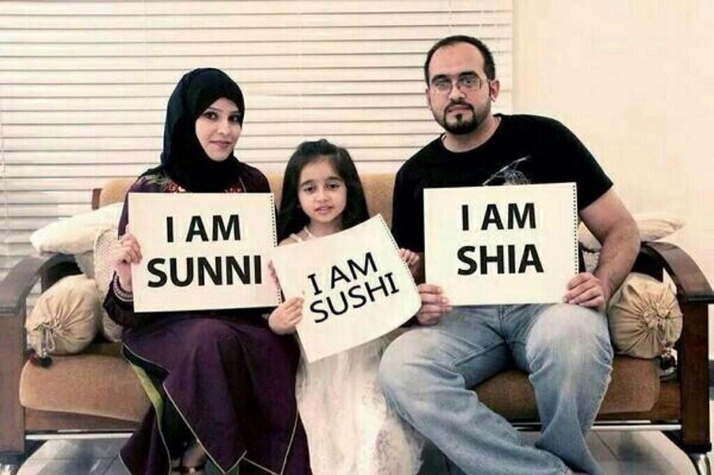
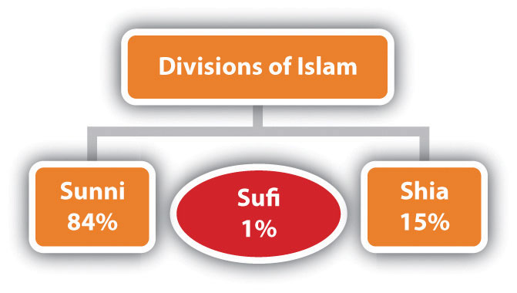
Muhammad never designated a successor; hence, after his death, bitter controversies arose concerning Muslim leadership. Rival claims to authority produced major divisions within the faith and armed conflicts that still exist today. The Sunni, from sunna, “the tradition of the Prophet,” consider themselves the orthodox of Islam. Representing approximately 85 percent of the modern Muslim worlds population, they hold that religious rulers should be chosen by the faithful.
Today, those known as Sunni are culturally diverse. Rather than try to achieve unanimity on all questions of doctrine, Sunni Islam has opted for a broadly accepted set of theological principals, and it has no structured religious hierarchy. Sunni Muslims can be found in many lands, from Indonesia to Africa and from Asia to the Arab communities of the Middle East.
By contrast, the Shiites (“partisans of Ali”) claim descent through Muhammad’s cousin and son-in-law Ali. They hold that only his direct descendants should rule. Shiite Muslims do not accept the first of the four “Rightly Guided Caliphs” as legitimate successors to Muhammad, simply because of their unconnected bloodline to the Prophet.

Slide 12
Scholarship in the Islamic World:
As Islam expanded, it absorbed many different styles from the arts of non-Arab peoples. “Islamic,” then, is a term used to describe the culture of geographically diverse regions-Arab and non-Arab—dominated by Islam.
Following Muhammad’s dictum to “seek knowledge,” Islam was enthusiastically receptive to the intellectual achievements of other cultures and aggressive in its will to understand the workings of the natural world. At a time when few Westerners could read or write Latin or Greek, Arab scholars preserved hundreds of Greek manuscripts, copying and editing them in Arabic translations.
Crucial to the advancement of learning was the Muslims translations of Hindu numbers, which replaced cumbersome Roman numerals with so-called “Arabic numbers” such as those used to number your textbook. Muslims also provided the West with such technological wonders as block printing and gunpowder.
Scholars of the Islamic world made original contributions in mathematics, medicine, sports, optics, chemistry, geography, philosophy and astronomy. Islamic physicians wrote treatises on smallpox, measles, and diseases transmitted by animals, on the cauterization of wounds, and on the preparation of medical drugs. The single most important medieval health book, the Tacuinium Sanitatis, originated among Arab physicians who examined the effects of various foods, drinks, and clothing on human well-being.
Muslim chemists invented the process of distillation and produced a volatile liquid called alkuhl, or alcohol.

Slide 13
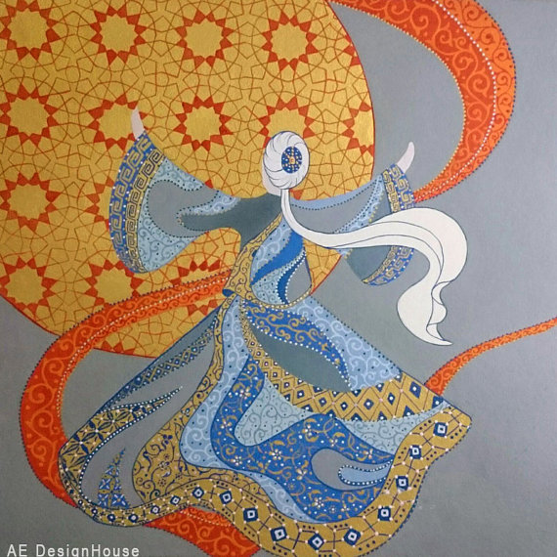
Sufism and the Arts:
One of the riches sources of artistic and literary inspiration in Islamic history was the movement known as Sufism, where some of the followers of Muhammad began to pursue a meditative, world-renouncing religious life that resembled the ideals of Christian and Buddhist aesthetics and Neoplatonic mystics.
The Sufi, so called for their course wool garments they wore, were committed to purification of the soul and mystical union with God through meditation, fasting, and prayer. Sufism placed increasing emphasis on visionary experience and the practice of intensifying physical sensation through music, poetry, and dance.
Sufi poetry, as represented in the works of the great Persian mystic and poet Jalal al-Din Rumi, also known as Mawlana or “Our Guide,” draws on the intuitive, non-rational dimensions of the religious experience.

Slide 14
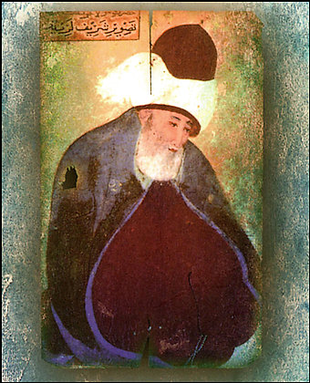
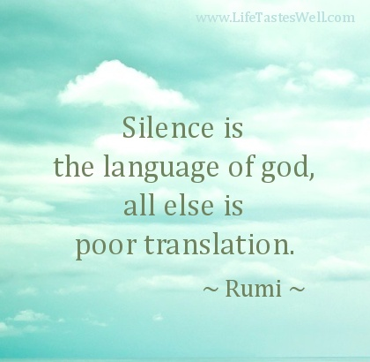




Slide 15
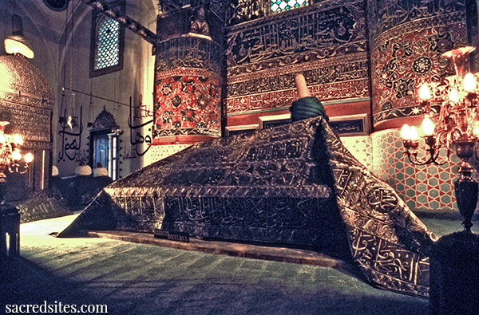
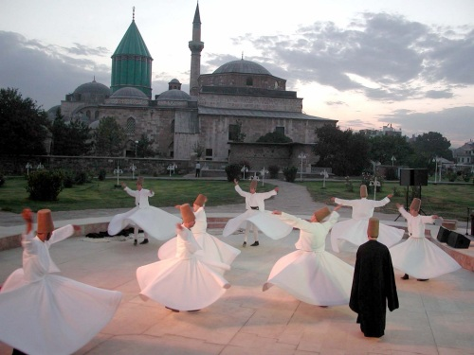
Rumi:
In contrast to general Islamic practice, Rumi placed much emphasis on ritual prayer instead of the analysis of the Qur’an for divine guidance. He was known for his ecstatic revelations. Rumi believed it was his task to communicate his visions and he wrote them down in the form of poetry.
Rumi believes that man is a link between the past and the future in a continual process of life, death, and re-birth—not as a cycle, but in a progression from one form to another, stretching into eternity. He believed that as something ceases to exist in one form, it is reborn in another, and because of this we should have no fear of death, nor should we grieve a loss.

Slide 16
Islamic Art and Architecture
Five times a day, at the call of muezzins (criers) usually located atop minarets (tall slender towers), Muslims are summoned to interrupt their activities, anywhere they are, to kneel and pray facing Mecca. The official place of worship, however, is the mosque: a large, columned hall whose square or rectangular shape derives from the simple urban house made of sundried bricks.
The design of the mosque is not, as with the early Christian church, determined by the needs of religious liturgy. Rather, the mosque is first and foremost a place of prayer. Every mosque is oriented toward Mecca, and that direction is marked by a niche located in the wall where sometimes a lamp that symbolizes Allah is kept. To the right of this niche is a small elevated platform where the Qur’an ay be read.
The Great Mosque in Cordoba, Spain, begun in 784 and enlarged over a period of 300 years, is one of the noblest examples of early Islamic architecture. Its interior consists of more than 500 double tiered columns that originally supported a wooded roof. The floor plan of the Great Mosque (now a Catholic cathedral), represents a sharp contrast with the design of the Early Christian basilica, which moves the worshiper in a linear fashion from portal to alter. At Cordoba, horseshoe-shaped arches consisting of contrasting wedges of white marble and red sandstone crown a forest of ornamental pillars.
Islam was self-consciously resistant to image-making. Like the Jews, Muslims condemned the worship of pagan idols and considered making likenesses of living creators an act of pride that “competed” with the Creator God. Therefore, in Islamic art, there is almost no three dimensional sculpture, and no pictorial representations of the kind found in Christian art. Islamic art also differs from Christian art in its avoidance of symbols.

Slide 17
How do Muslims and Christians Differ?
Muslims do not consider Jesus divine or to be the son of God. They DO consider him to be an extremely important prophet and the DO believe he was born of the Virgin Mary.
Regarding the death and resurrection of Jesus, Muslims believe that he was such an admired and important prophet, that when his enemies were about to crucify him, God lifted him up to Heaven, avoiding the persecution of being crucified. He is not believed to have resurrected in the Muslim faith.
Muslims believe that Ishmael was indeed a legitimate son of Abraham’s and they trace their lineage through Ishmael.
Jewish/Christians believe that Isaac was the true first son of Abraham and they race their lineage through Isaac.

Slide 18
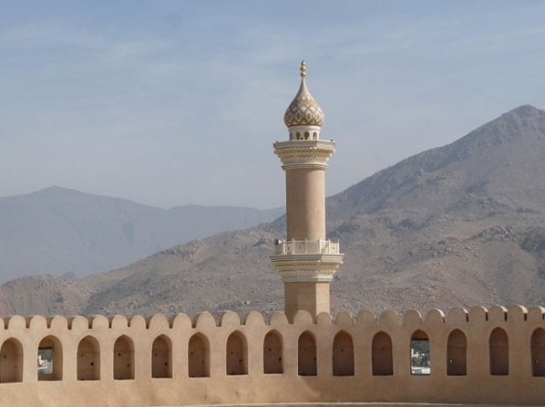
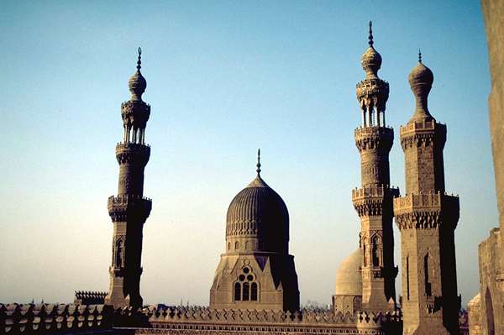
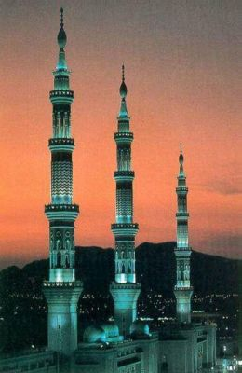
Minarets in Islamic Architecture

Slide 19
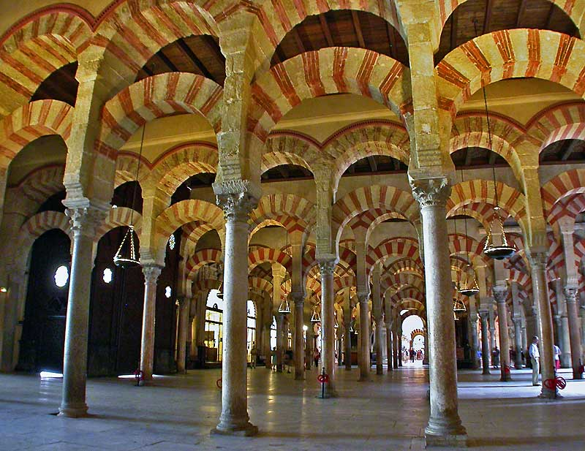
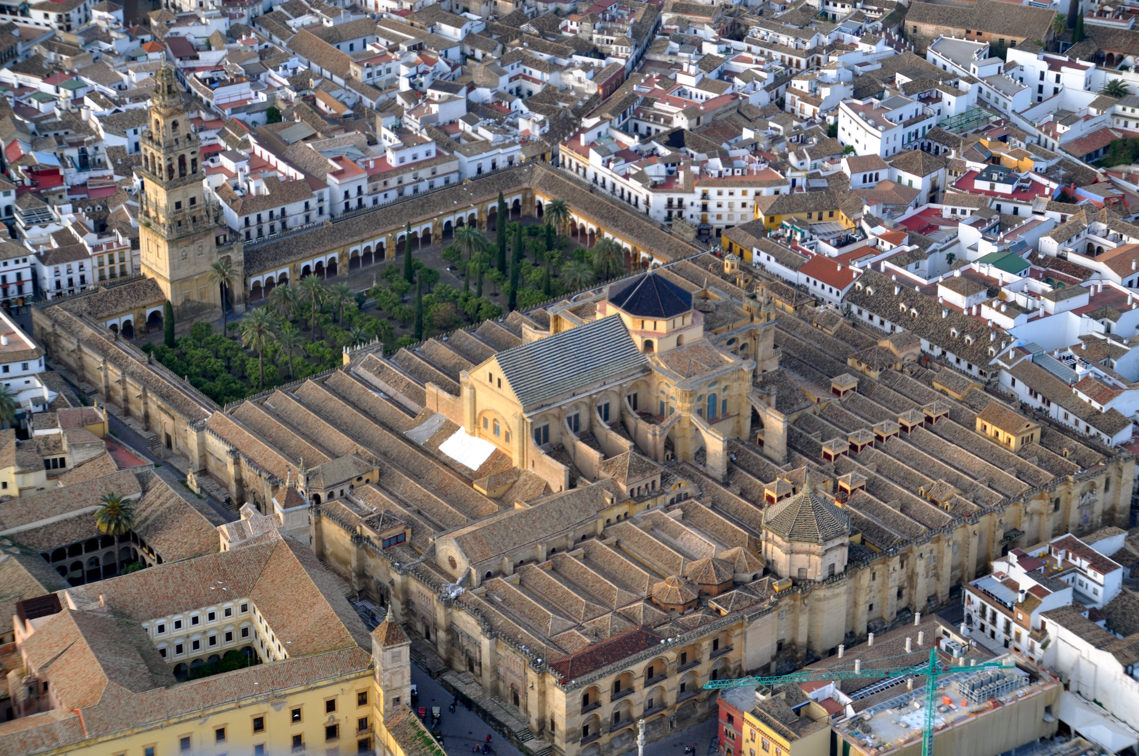
The Great Mosque
Cordoba, Spain

Slide 20
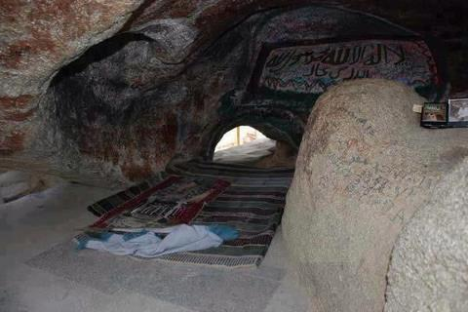
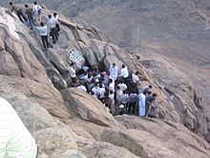
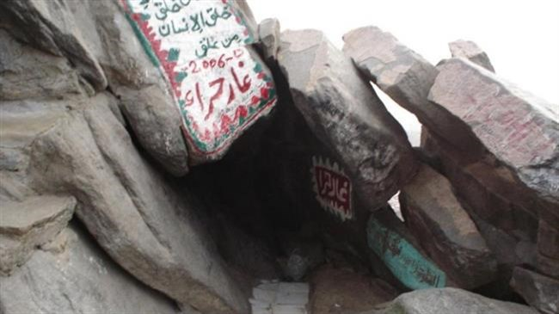
Cave of Hira, Saudi Arabia

Slide 21
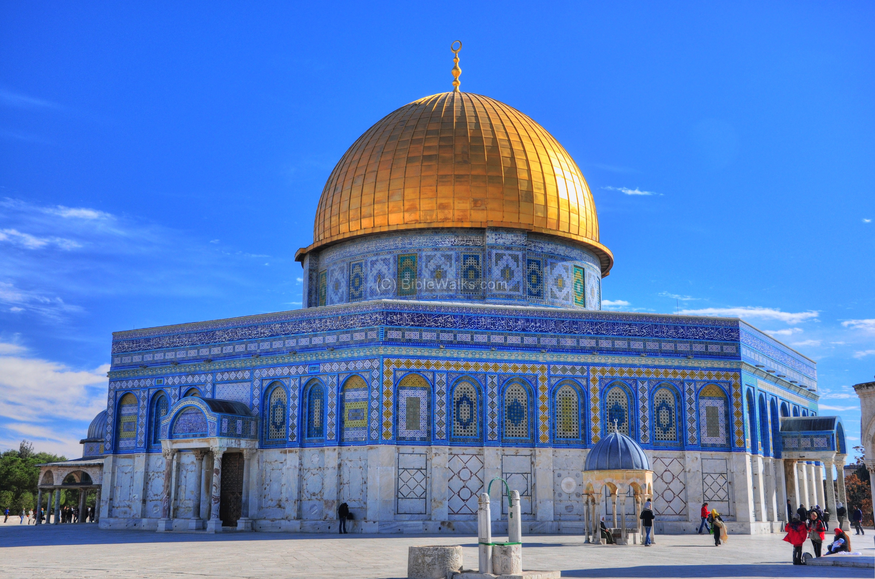
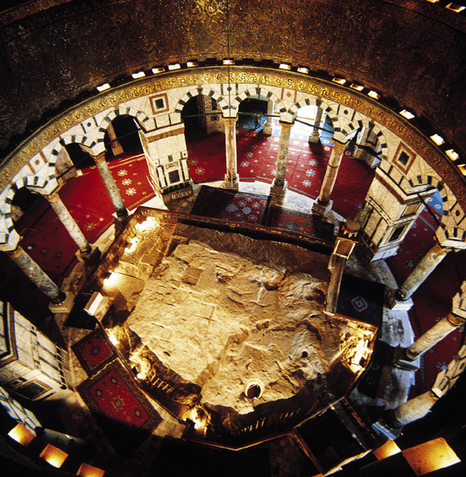
Dome of the Rock
Jerusalem, Israel

Slide 22
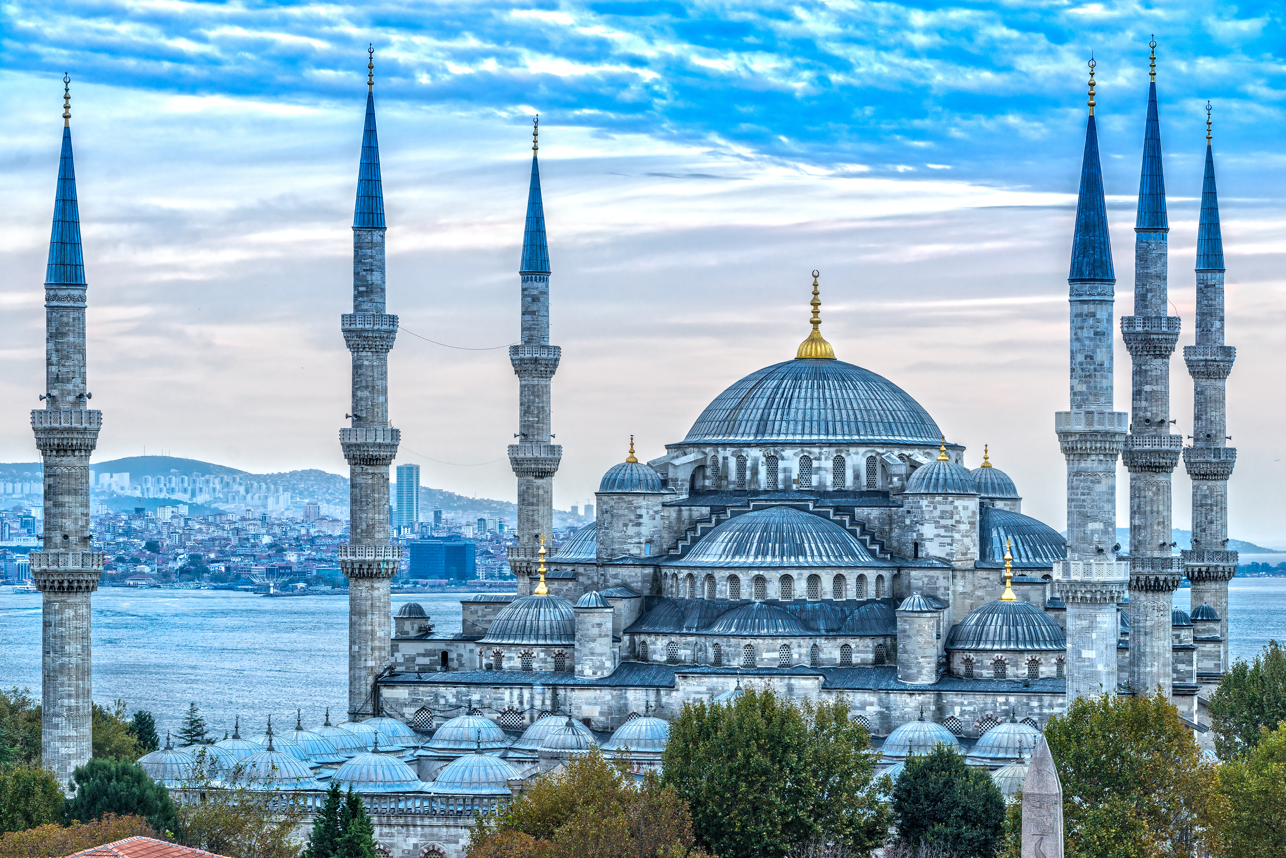
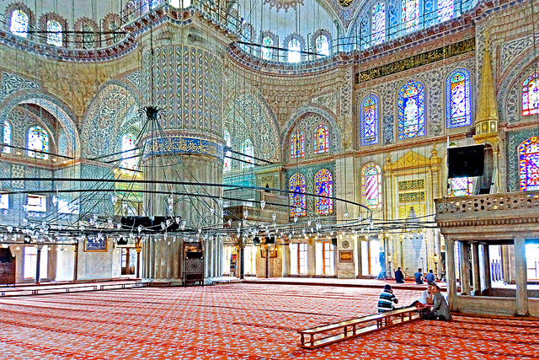
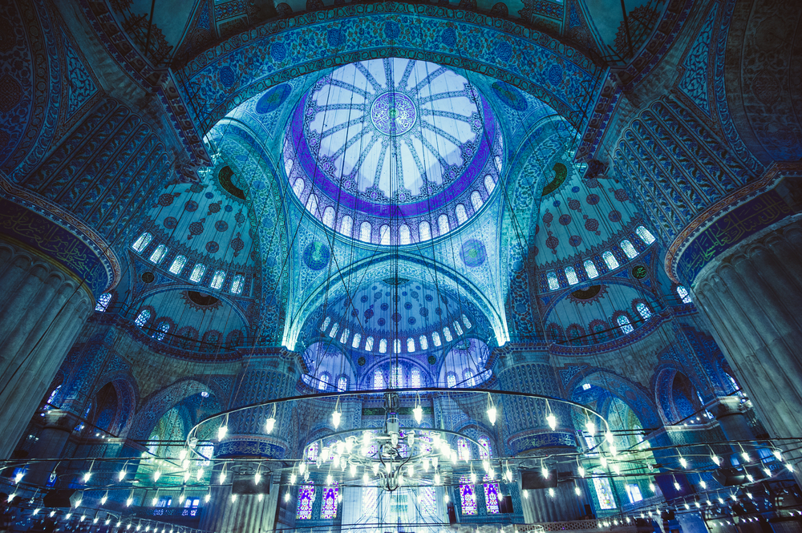
The Blue Mosque, Istanbul, Turkey

Slide 24
Three types of motifs dominate the Islamic decorative repertory: geometric, floral, and calligraphic. Geometric designs, drawn largely from a Classical repertory, were developed in complex patterns. Abstract, interlocking shapes often enclose floral motifs that feature the arabesque, a type of ornamentation based on plant and flower forms, inspired by Byzantine and Persian art. Calligraphy completes the Islamic vocabulary of ornamentation. In Islamic art, where the written word takes precedence, calligraphy assumes a sacramental character. Most calligraphic inscriptions were drawn from the Qur’an.
Whether calligraphic, floral, or geometric, Islamic motifs are repeated in seemingly infinite, rhythmic extension, bound only by the borders of the frame. This device may be viewed as the visual equivalent of the frame tale, in which individual stories are incorporated into the whole.
“Meander and frame”-an expression of the universal theme of variety and unity in nature-is a fundamental principal of the Islamic decorative tradition and of Islamic aesthetics. The aesthetic of infinite extension sees Truth as intuitive and all-pervasive, rather than apocalyptic and self-fulfilling.
The bold use of color is one of the key features of Islamic art and architecture. Complex surface designs executed in mosaics and polychrome patterned glass tiles transform the exteriors of mosques and palaces into shimmering veils of light and color. At the Dome of the Rock, the earliest surviving Islamic sanctuary, Qur’anic inscriptions in gold mosaic cubes on a blue ground wind around the spectacular octagon. Constructed on a 35-acre plateau in east Jerusalem, the sanctuary is capped by a gilded dome. Both in its harmonious proportions and its lavishly ornamented surfaces, the structure is a landmark of the Muslim faith. It is believed to crown the site of the creation of Adam, and mark the spot from which Muhammad ascended to Heaven. It is also said to be the site of the biblical Temple of Solomon.

Slide 25
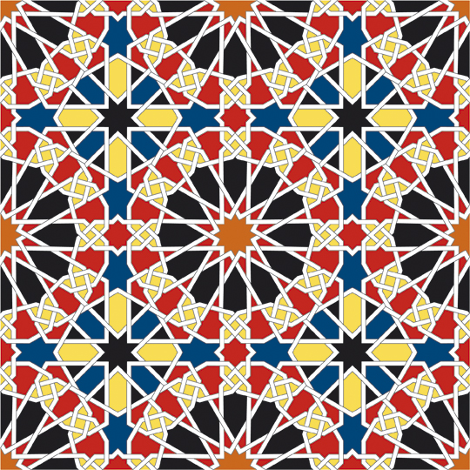
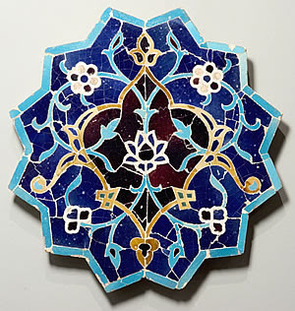
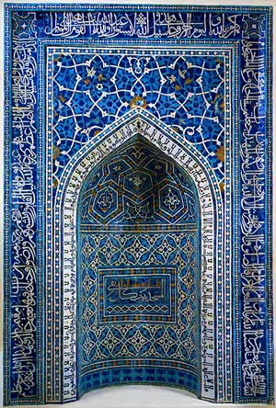
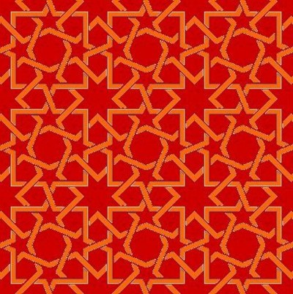
Early Islamic
Geometric
Art

Slide 26
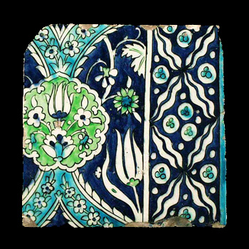
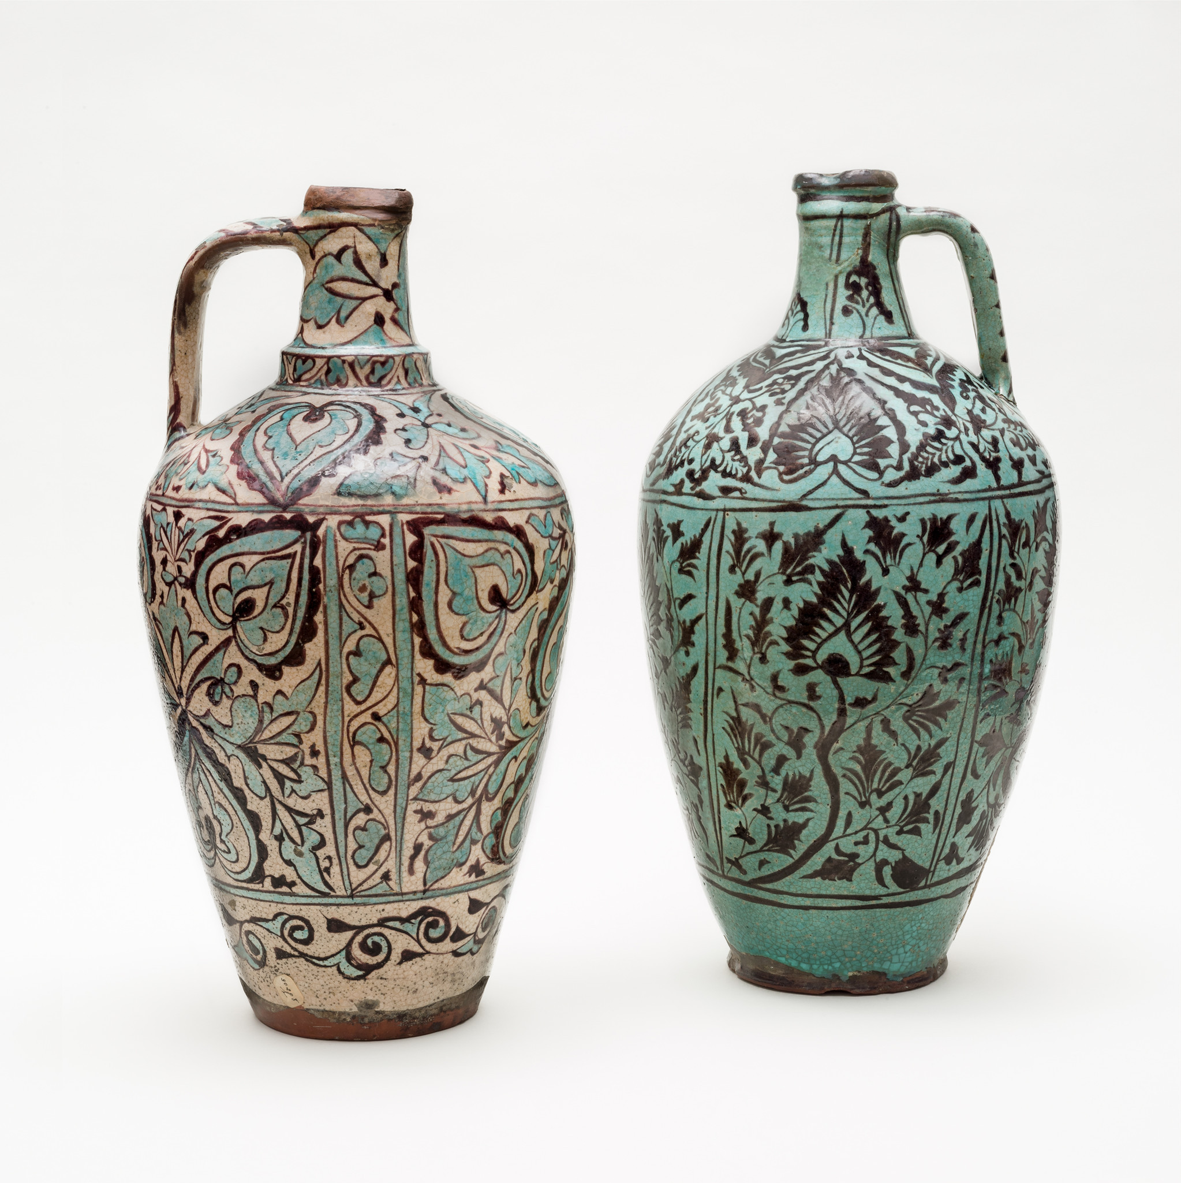
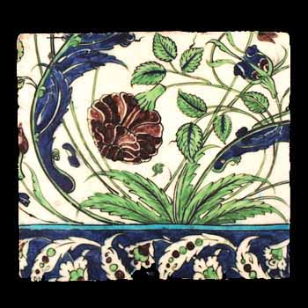
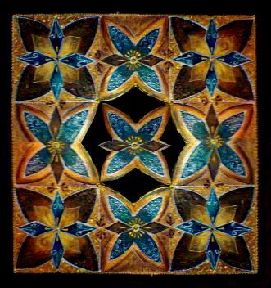
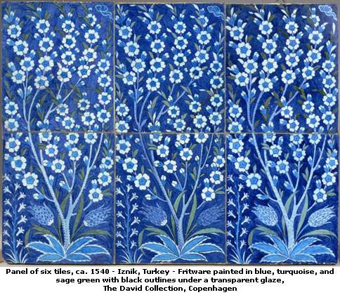
Early Islamic Floral Art

Slide 27
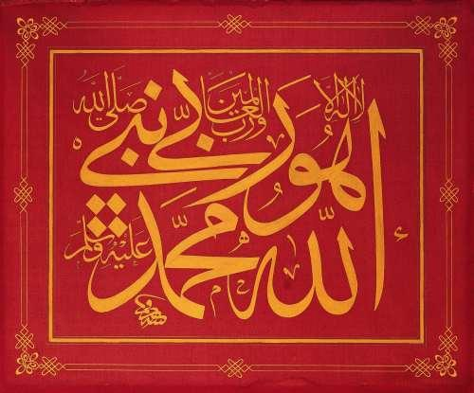
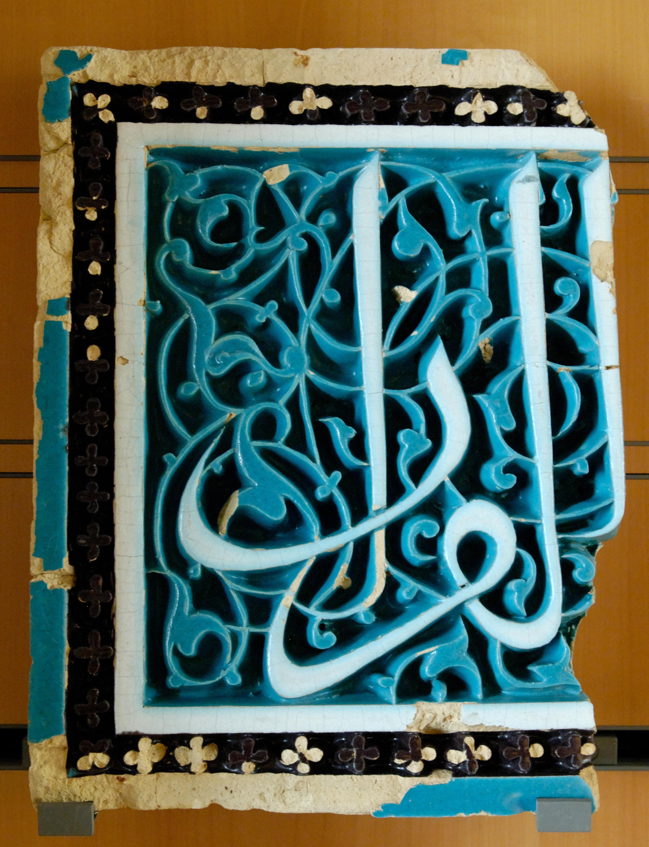
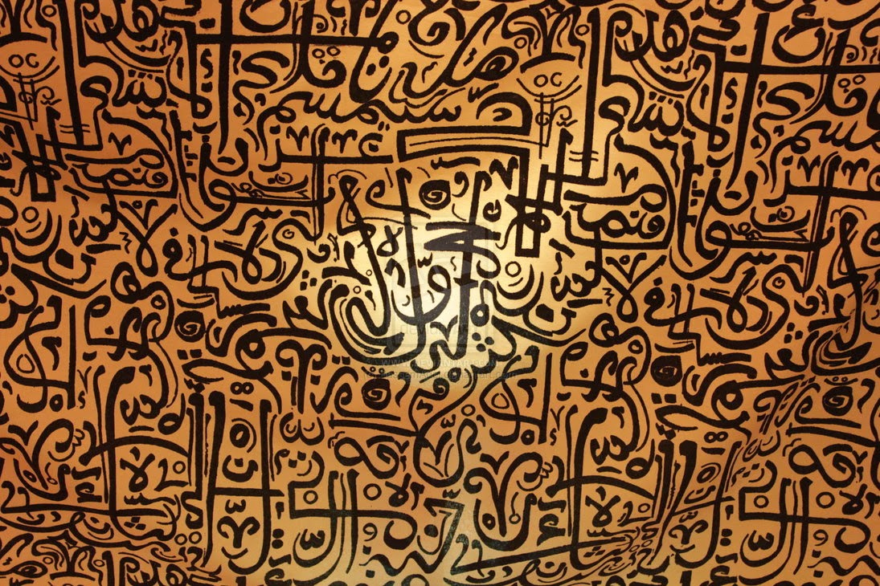
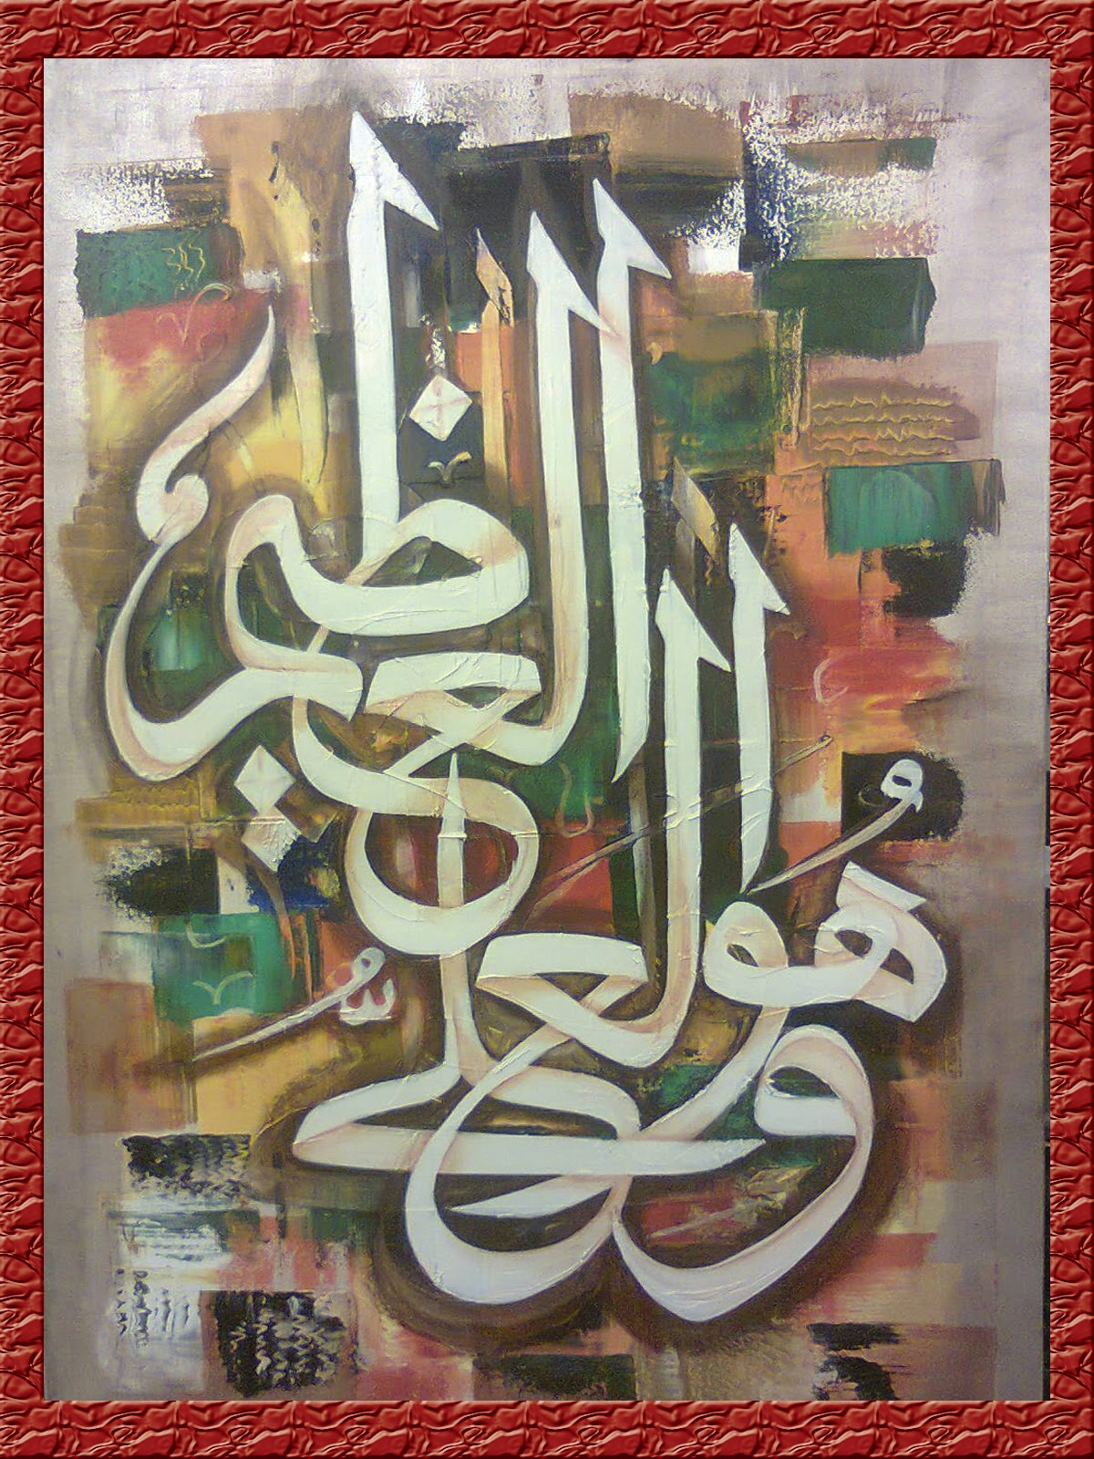
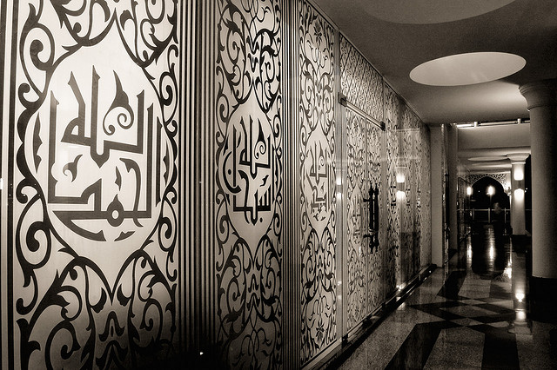
Early Islamic Calligraphic Art

Slide 28
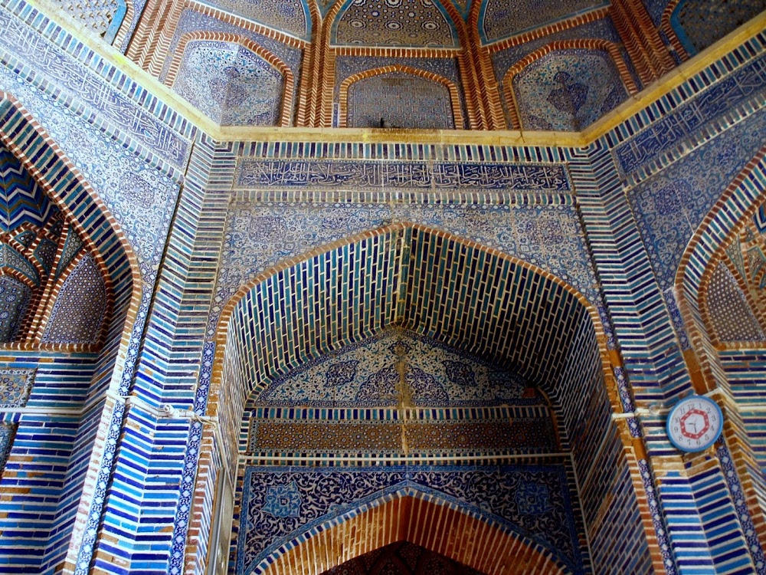
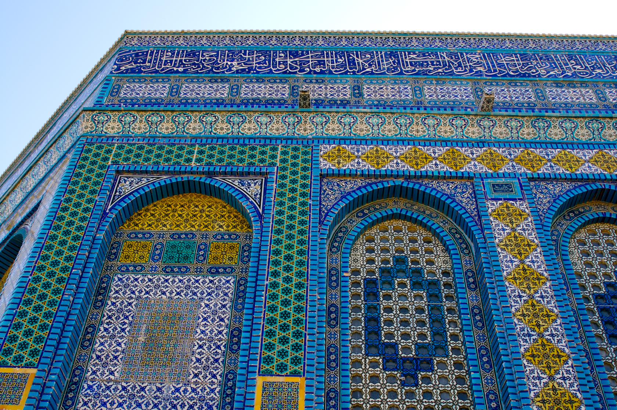
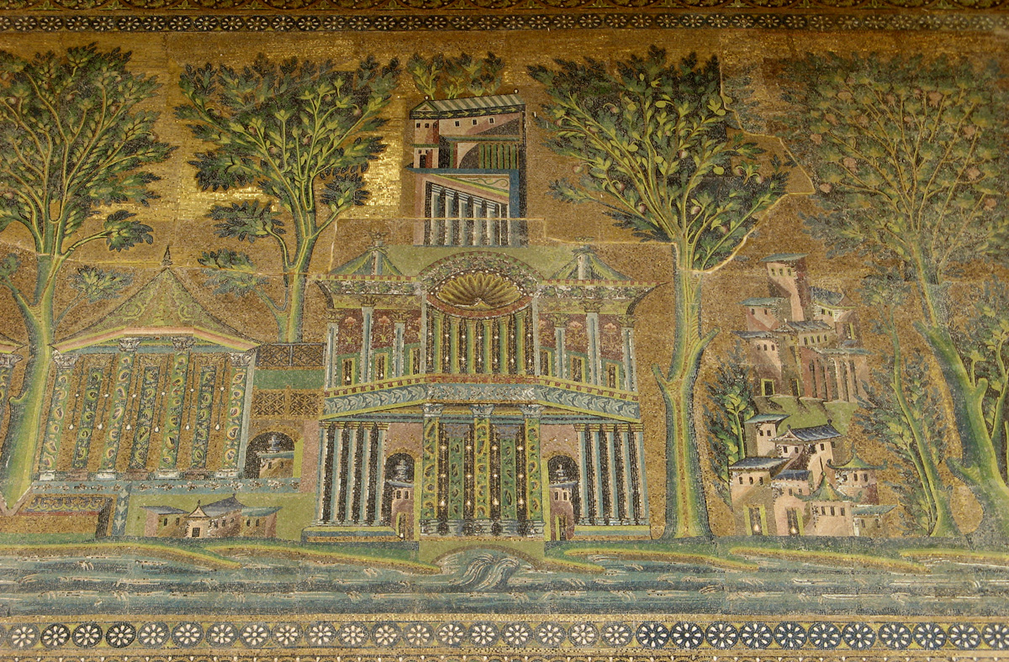
Islamic Mosaic:

Slide 29
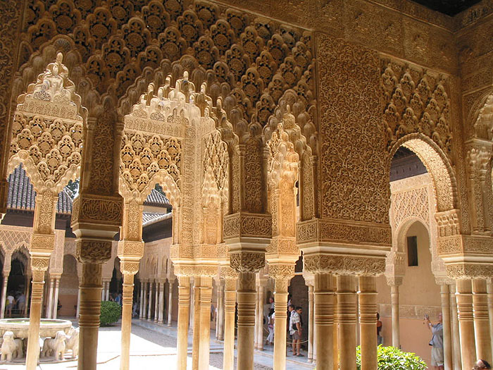
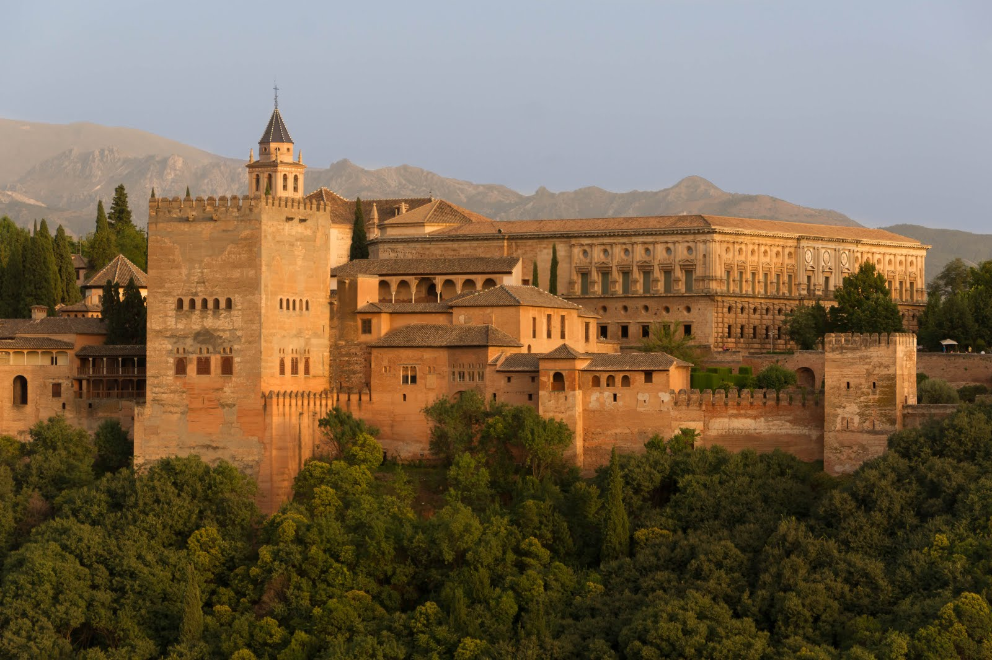
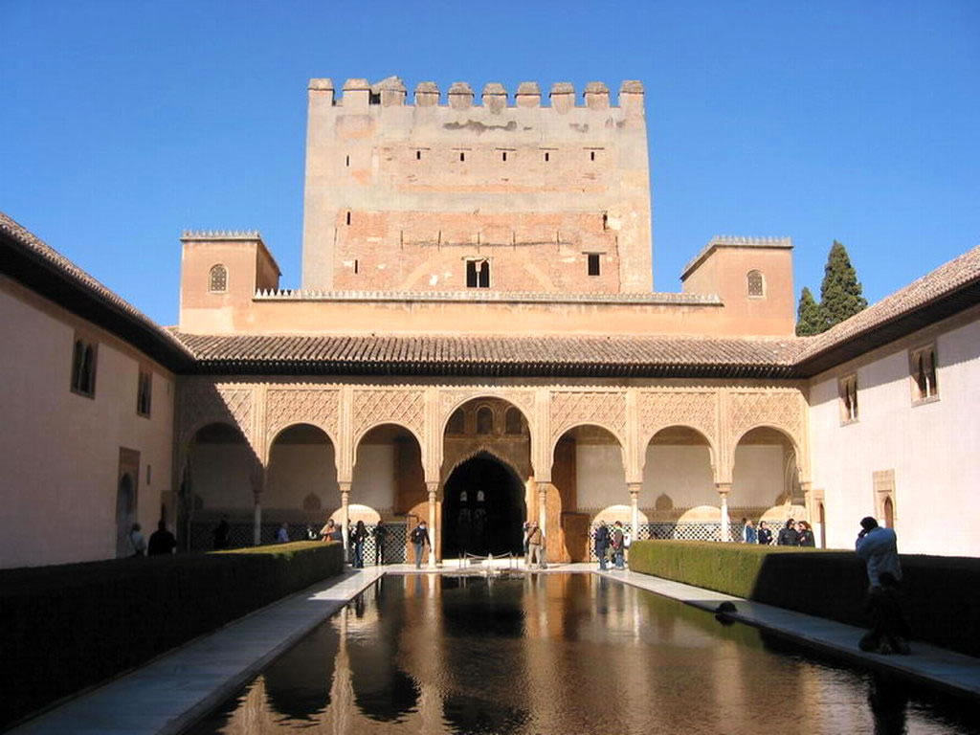
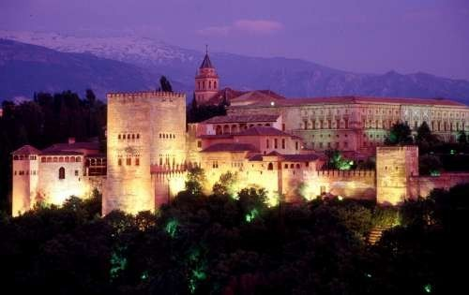
The Alhambra
Granada, Spain

Slide 30
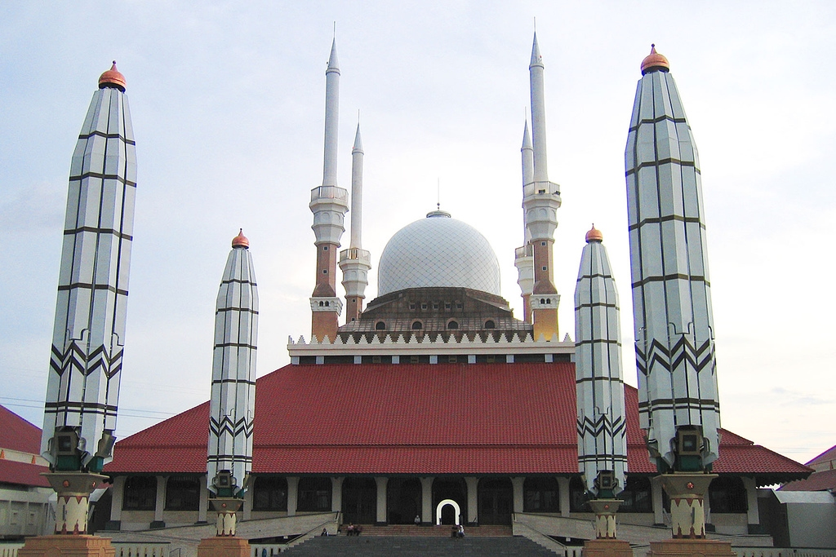
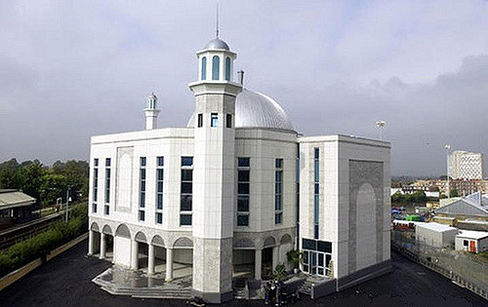
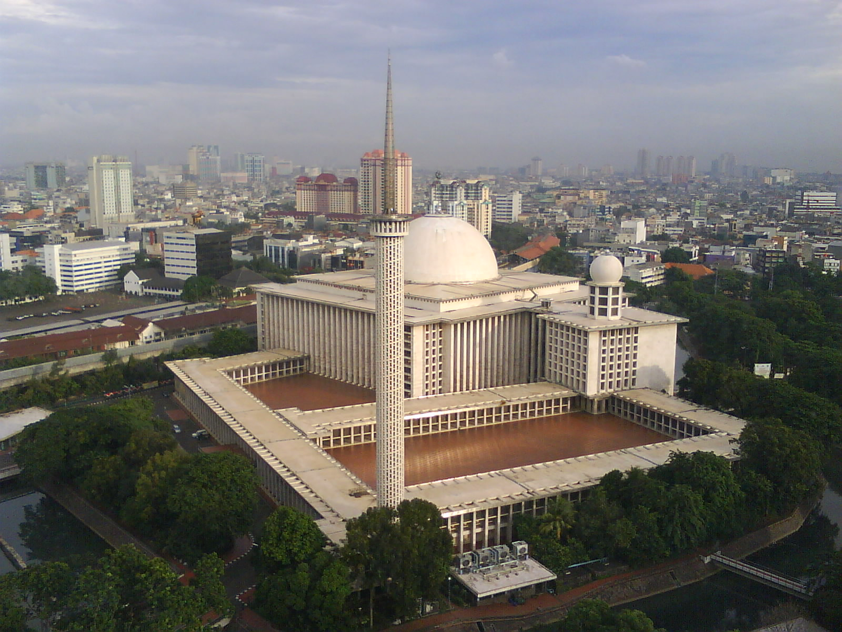
Making Connections:

Slide 31
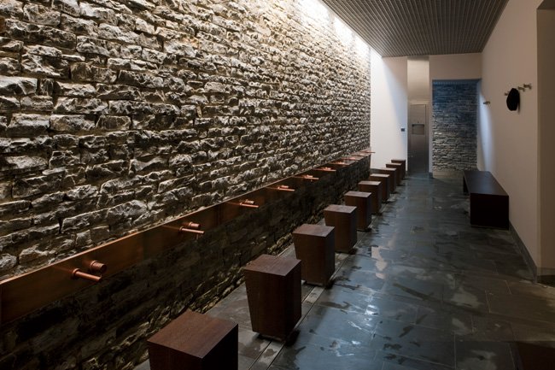



Sancaklar Mosque, Turkey

Slide 32




Making Connections:

Slide 33




Making Connections:

Slide 34





Slide 35
Music in the Islamic World
For the devout Muslim there was no religious music other than the sound of the chanted Qur’an and the crier’s call to prayer. Muslims regarded music as a forbidden pleasure and condemned its “killing charm.” During Islam’s golden age, secular music flourished in the courts of Cordoba and Baghdad, and, even earlier, Arab song mingled with the music of Persia, Syria, and Egypt.
The music of the Islamic world originated in the songs of the desert nomads-songs featuring the solo voice and unmeasured rhythms. The music of Arabia consisted of a singe melodic line, either unaccompanied or with occasional instrumental accompaniment. Two additional characteristics of Arab music are its use of microtones, and its preference for improvisation. Both of these features, which also occur in modern jazz music, work to give Arab music its unique sound.
In its linear ornamentation and it repetitive phrasing, Arab music has much in common with literary and visual forms of Islamic expression. Instrumental music took a second place to the voice everywhere in the Islamic world, except in Persia, where a strong pre-Islamic instrumental tradition flourished. Lyres, flutes, and drums were used to accompany the songs of the Bedouin camel drivers, with bells and tambourines providing the percussion for dancing.
Muslim musicians in Spain began to compose larger orchestral pieces performed by wind and string instruments, percussion, and voices sometime after the eighth century. Music composition and theory reached a peak between the ninth and eleventh centuries, when noted Islamic scholars wrote almost 200 treatises on musical performance and theory.

Slide 36
Need To Know- Chapter 10
Orphaned at the age of six, and raised within a traveling caravan, Islamic prophet Muhammad came into contact with communities of Jews, Christians, and pagans. The Angel Gabriel appeared to Muhammad with the message to receive the word of Allah.
Islam shared similarities with both Judaism and Christianity. Commonalities with Judaism are a strict set of ethical and social views, as well as dietary laws, and with Christianity Islam shares the belief in an immortal soul and an anticipation of a final judgment.
Muhammad’s followers are called Muslims, or “those who submit to Allah.” Muslims follow the Qur’an, which provides guidelines for worship, and specific moral and social injunctions for everyday conduct.
Following Muhammad’s death, the Muslim religion broke into two factions. The Sunni consider themselves the orthodox of Islam and represent 90% of the Muslim religion worldwide. They believe religious leaders should be chosen by the faithful. In contrast, the Shiites claim descent through Muhammad’s cousin and son-in-law, Ali. They believe only his direct descendants should rule.
Jihad, or “holy war,” signifies all aspects of the Muslim drive toward moral and religious perfection, including the defense and spread of Islam.
Three types of motifs dominate the Islamic decorative arts: geometric, floral, and calligraphic.

